Slide 1
CLOUD WATCH
Amazon CloudWatch is a monitoring service for AWS cloud resources and the applications you run on AWS. You can use Amazon CloudWatch to collect and track metrics, collect and monitor log files, set alarms, and automatically react to changes in your AWS resources. Amazon CloudWatch can monitor AWS resources such as Amazon EC2 instances, Amazon DynamoDB tables, and Amazon RDS DB instances, as well as custom metrics generated by your applications and services.
Once you logged into AWS under Console Home page, choose CloudWatch under management tools.
Then click Dashboards on the CloudWatch page from the left navigation pane.

Slide 2
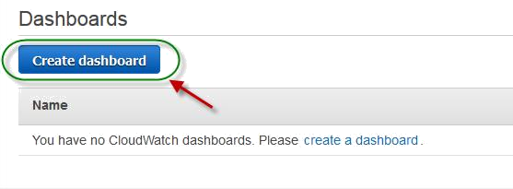
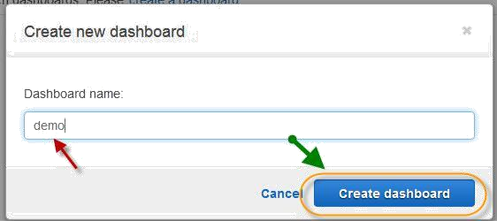
On the next page, choose Create Dashboard to create a new one.
On Create new dashboard dialog box, specify a name for dashboard choose Create dashboard.

Slide 3
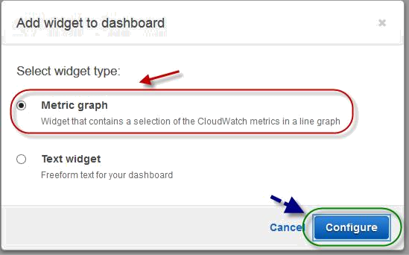
Once dashboard created, choose one widget from widget dialog box and click on configure.
Next, choose one of the metrics from the Cloud watch metrics by category dialog box.

Slide 4
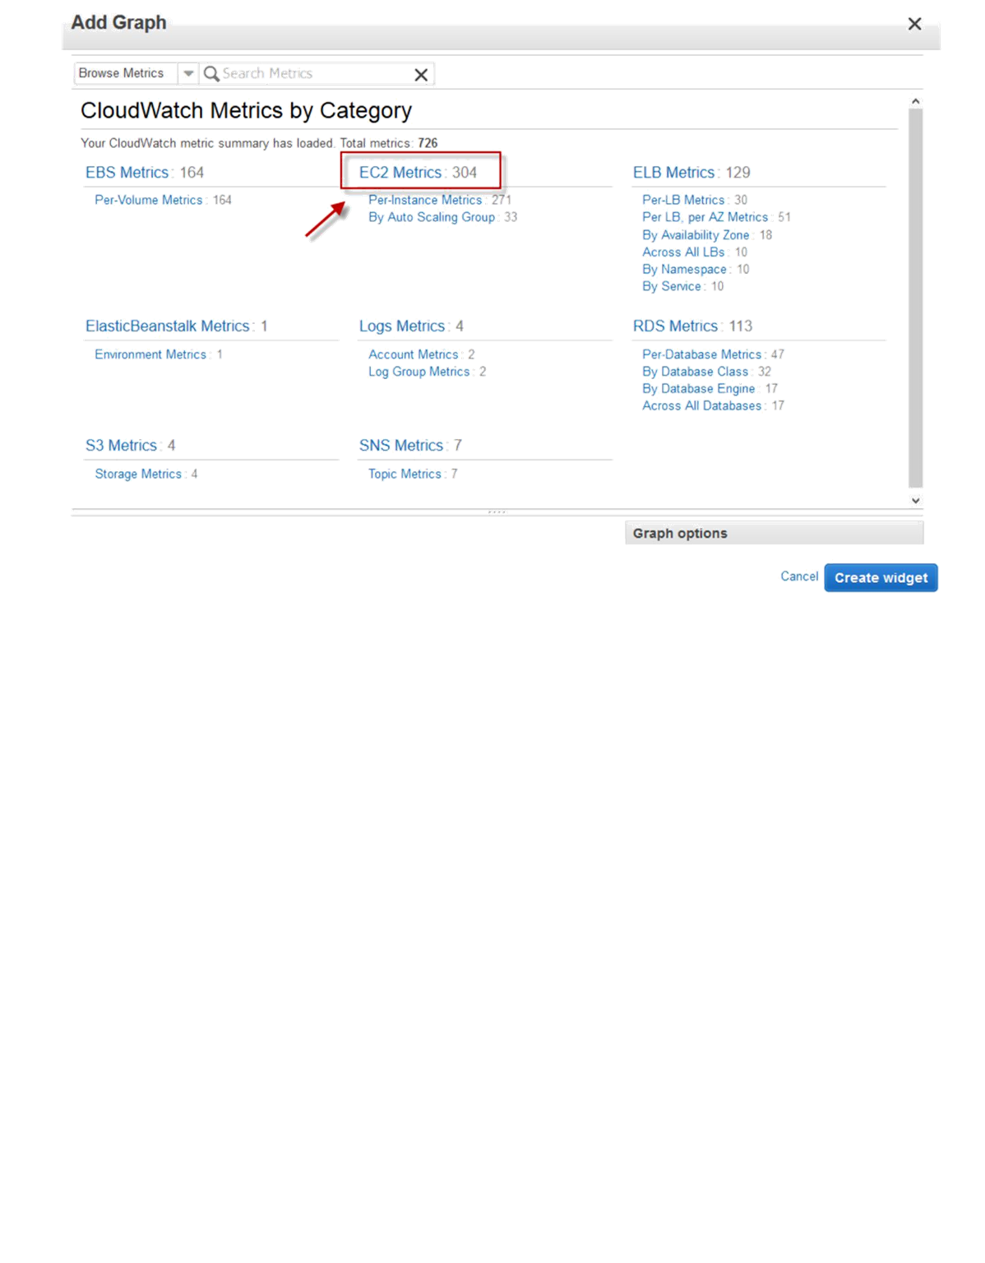
Select multiple instances and click on Create Widget.

Slide 5
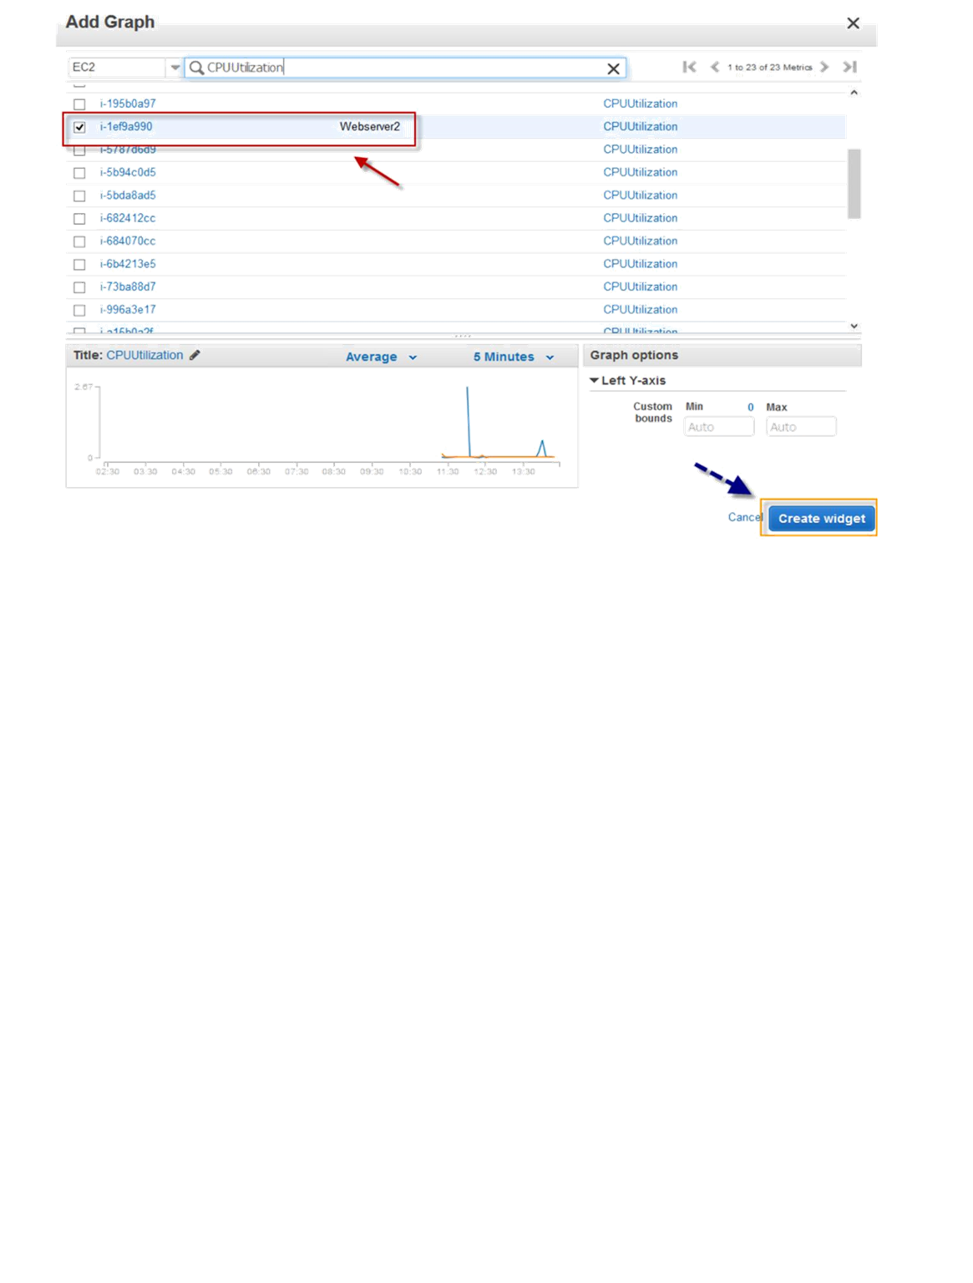
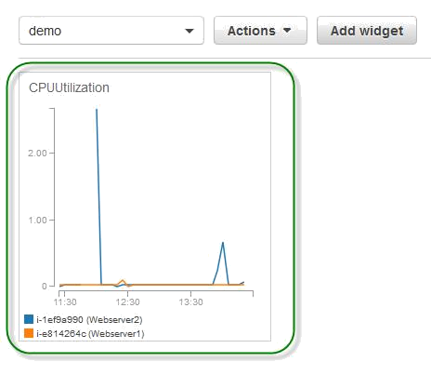
Graph will be created with instances which selected will added to your dashboard.
From the newly created dashboard, click add widget to add more graphs.

Slide 6
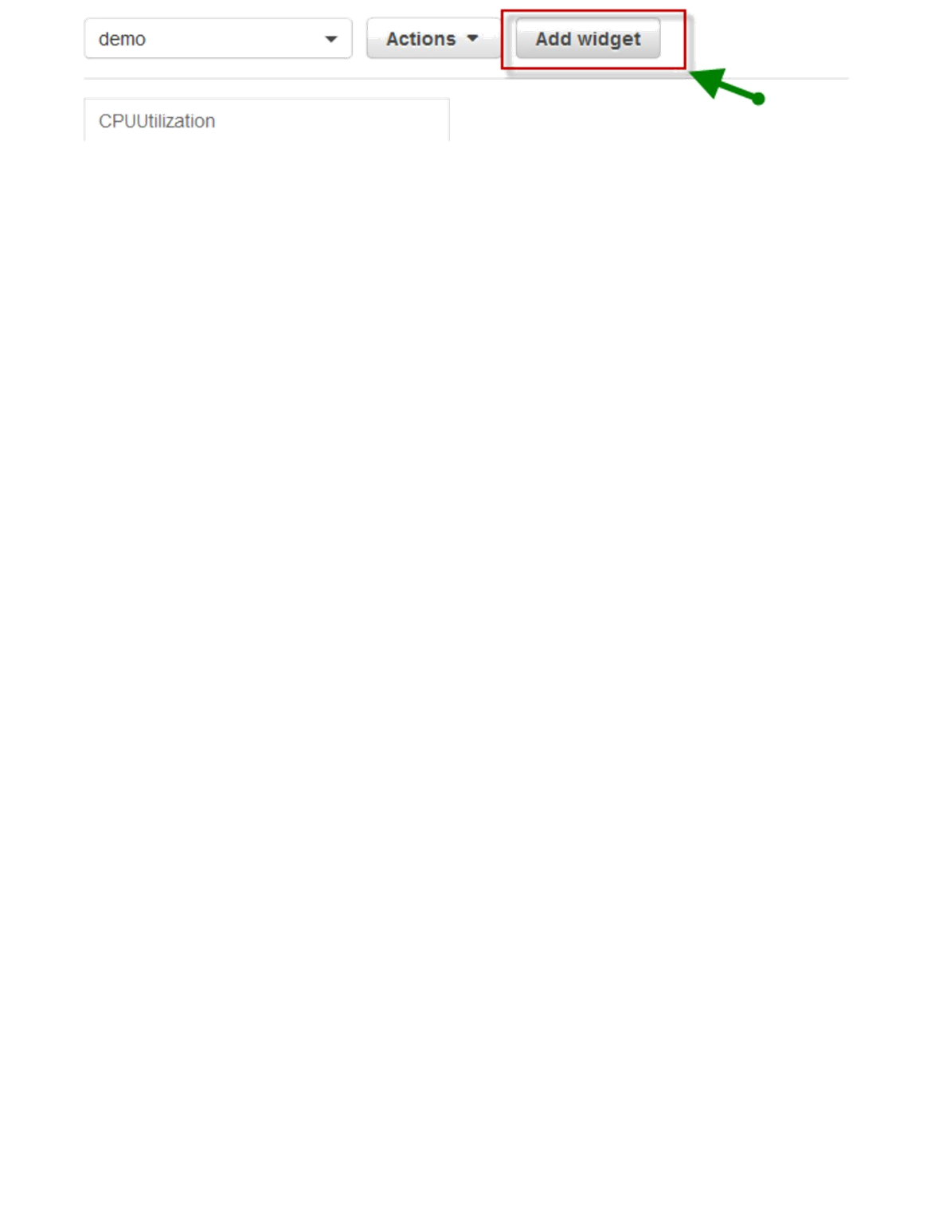
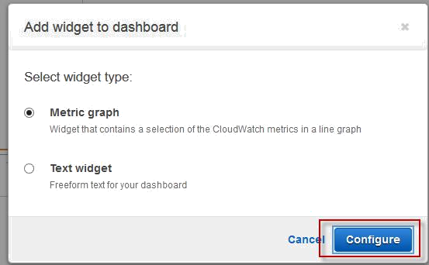
Choose your widget type and click on configure on add widget dashboard dialog box.
Next, choose one of the metrics from the Cloud watch metrics by category dialog box.

Slide 7
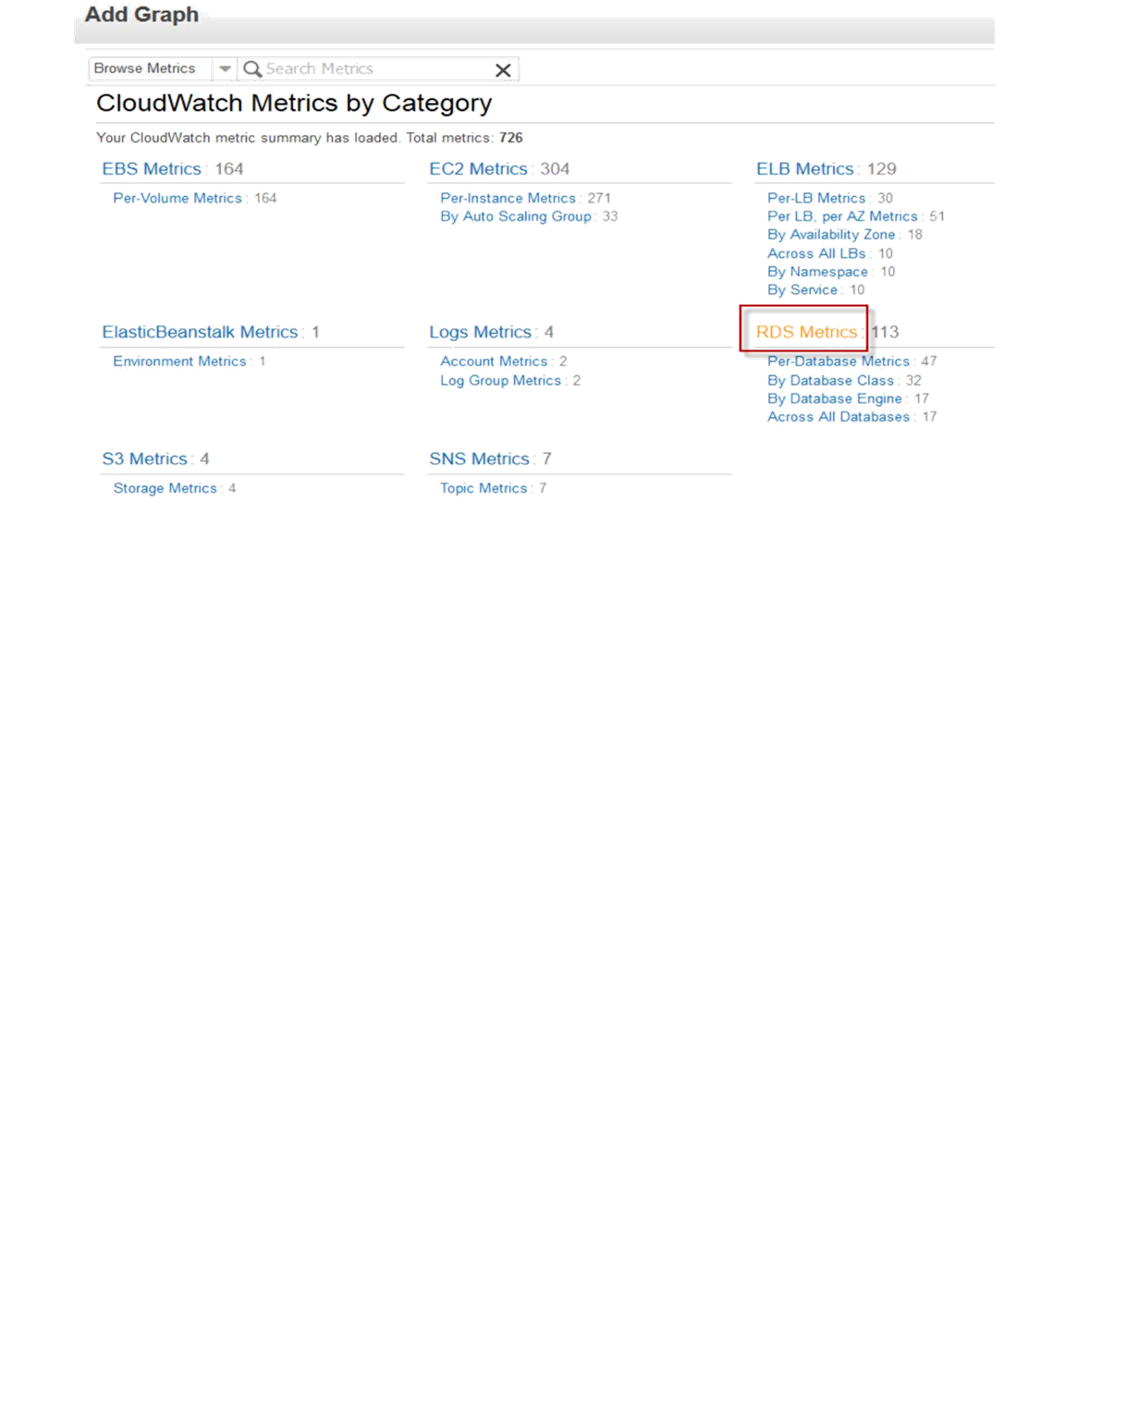
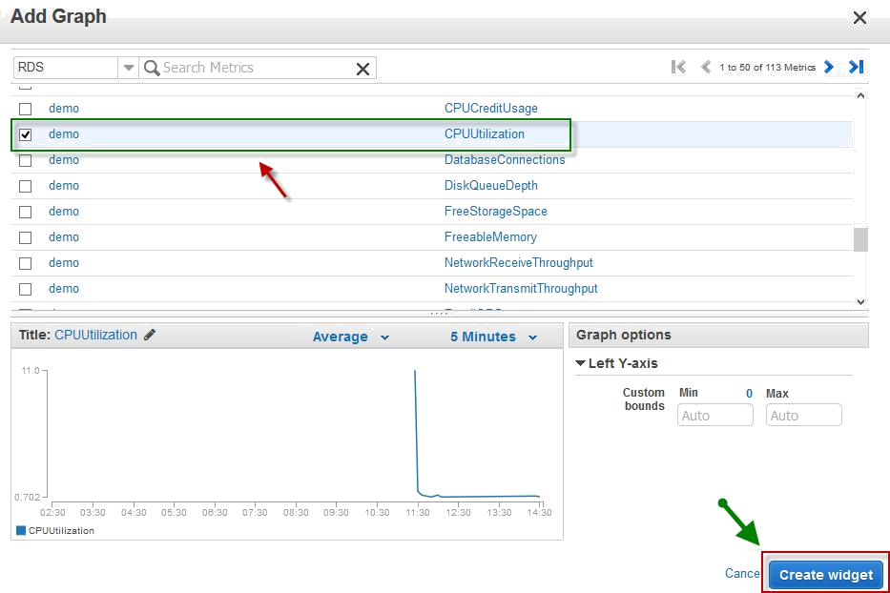
Choose RDS instance with respective metric and click on Create Widget.
Your attached graphs will be shown on your dashboard.

Slide 8
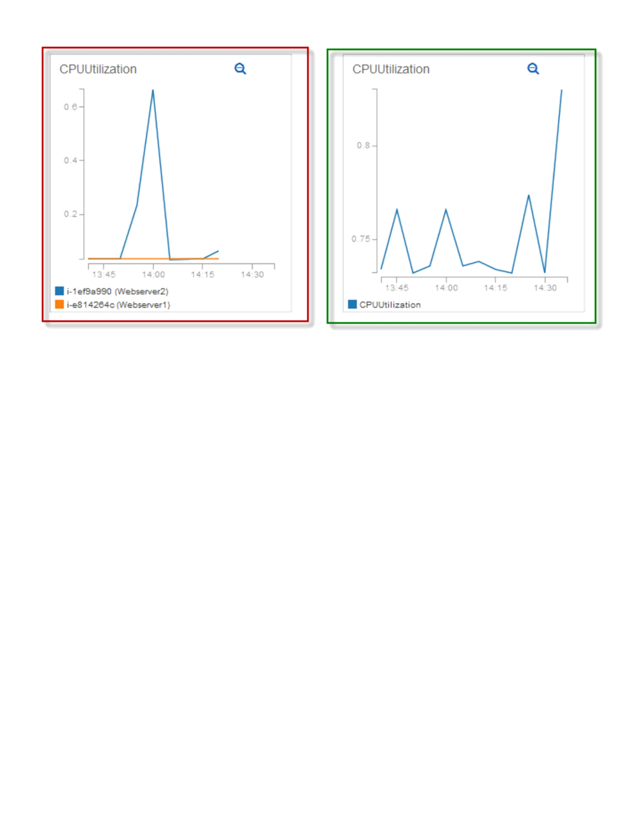
CREATING FIRST ALARM

Slide 9
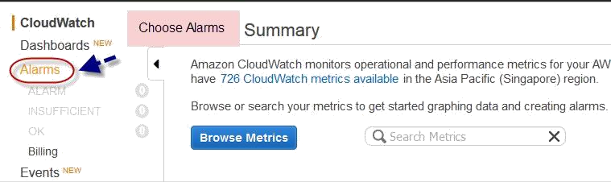
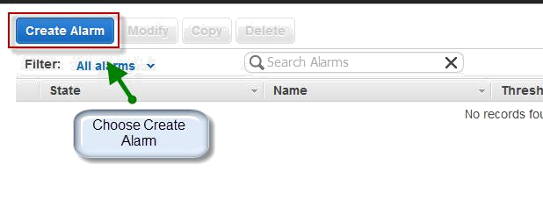
From the CloudWatch dashboard select Alarms from left navigation pane.
Click on Create Alarm from top of the page.
Choose EC2 Metrics from Cloudwatch metrics by category dashboard.

Slide 10
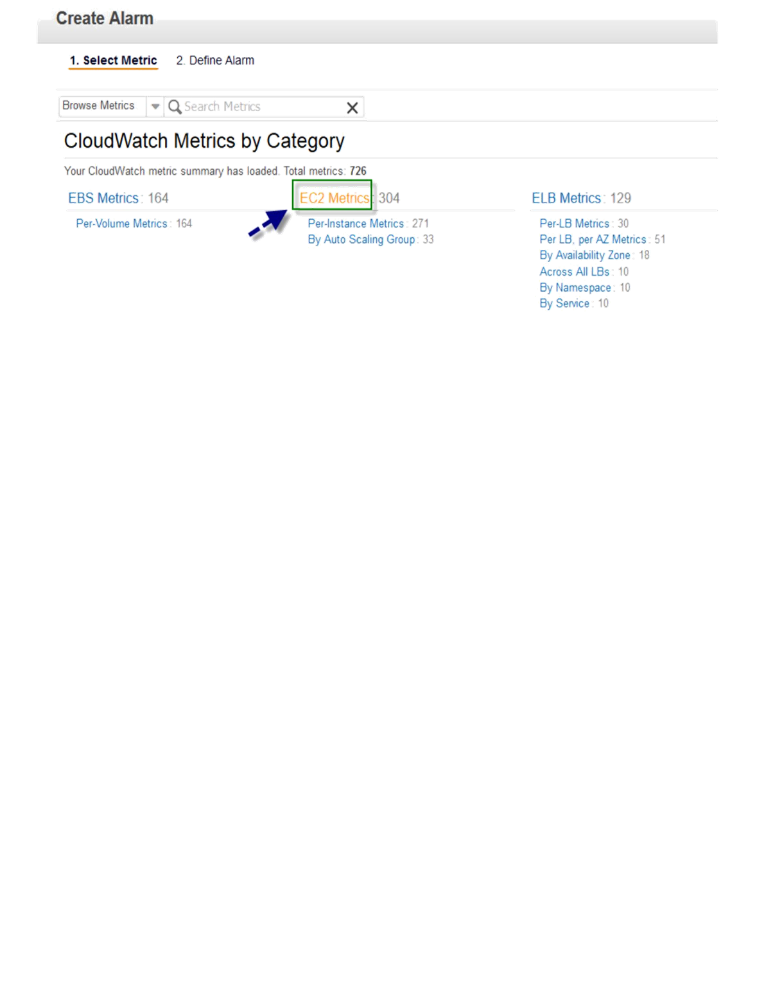
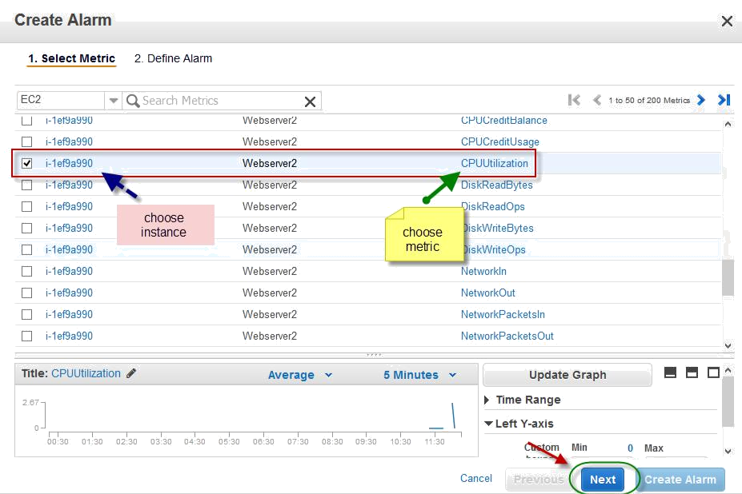
Select your instance which you want to create an alarm, and choose metric type, the click next.
In define alarm page, specify a name for alarm, add description.

Slide 11
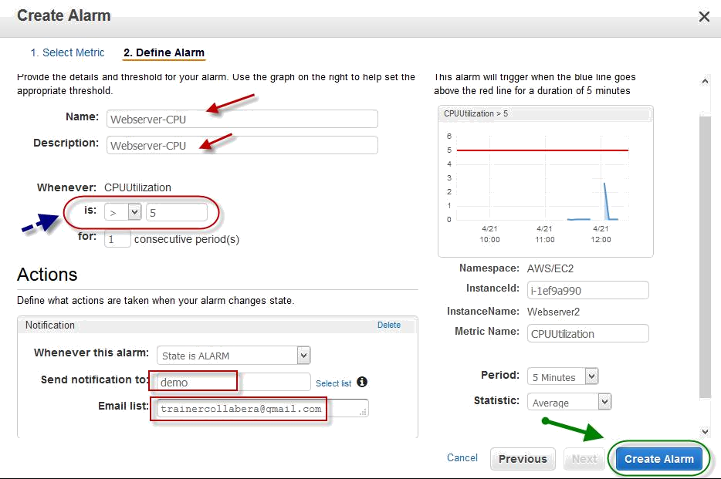
Choose when to trigger an alarm, like trigger an alarm when instance CPU reaches or crossed some percentage.
In Actions dialog box, make sure it is selected as State is ALARM.
Select SNS topic if you already have one created, or choose new list on Send notification to text box.
Specify email address if you choose new list. Then click on Create Alarm.
If you choose new list under Actions page, then you will be asked to confirm the subscription with in a dialog box with a confirmation mail sent to specified mail id.

Slide 12
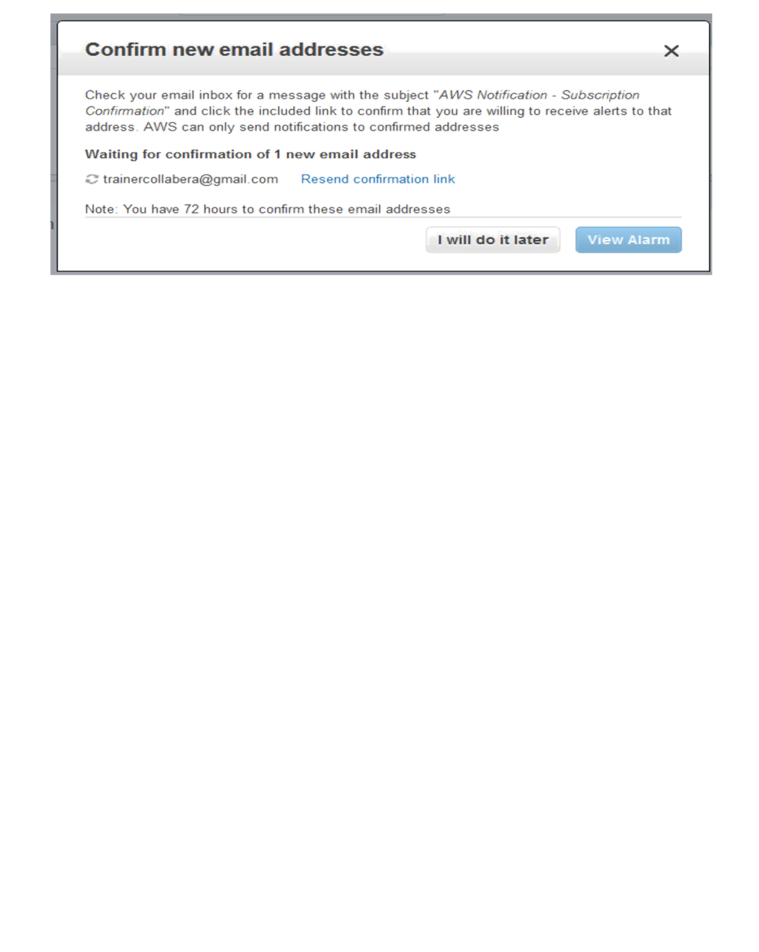
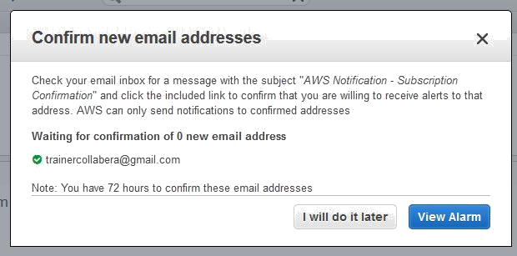
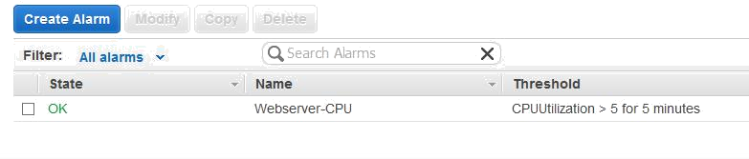
Once confirmed, you can see the same has been updated in the dialog box.
Click on View alarm to see created alarm on Alarm page under Cloud watch.
CREATE CLOUDWATCH ALARM FOR RDS

Slide 13


From the CloudWatch dashboard select Alarms from left navigation pane.
Click on Create Alarm from top of the page.
Choose RDS Metrics from Cloudwatch metrics by category dashboard.

Slide 14
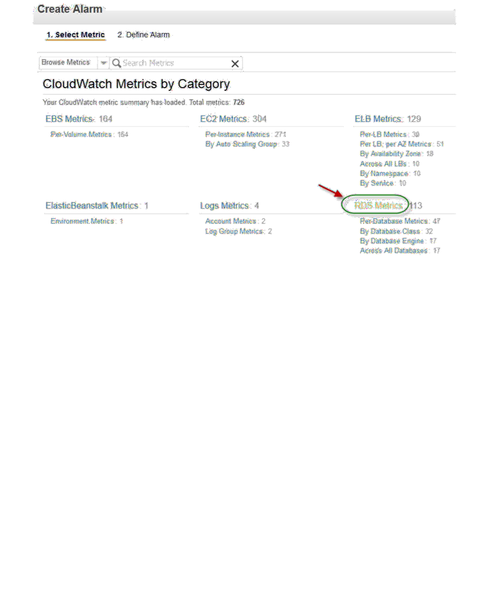
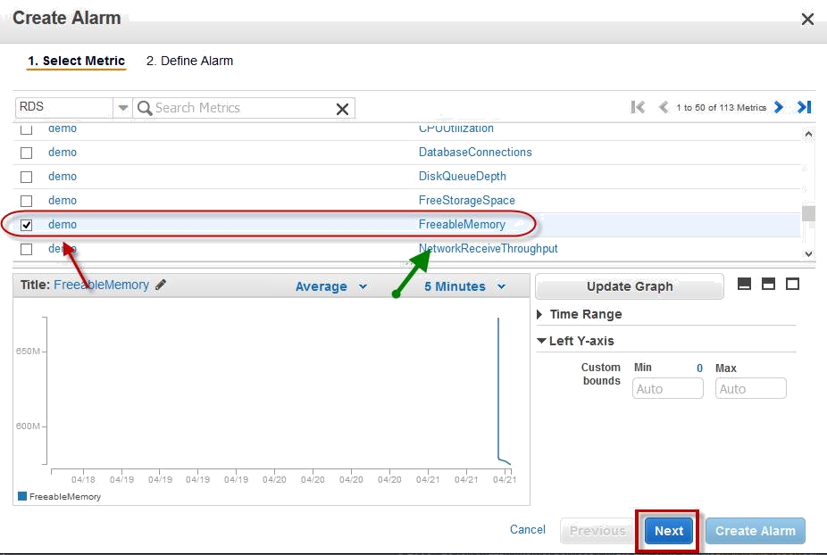
In create alarm page, select your RDS instance with respect to your metric, then click next.
In define alarm page, specify a name for alarm, add description.

Slide 15
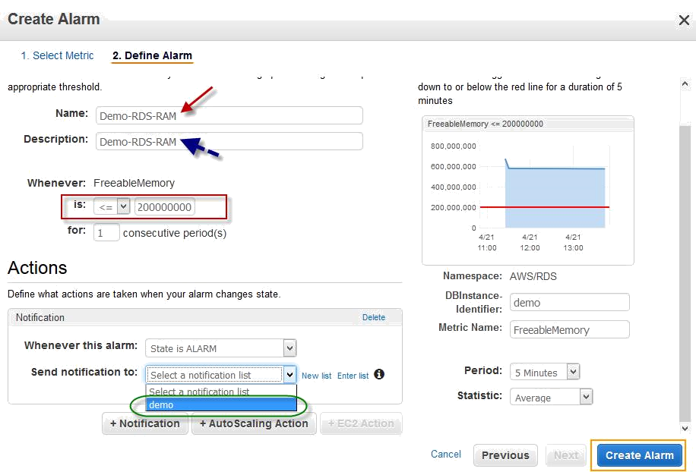
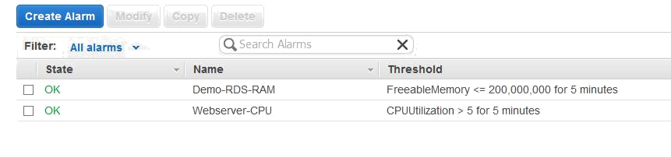
Choose when to trigger an alarm, like trigger an alarm when RDS instance RAM having low memory.
In Actions dialog box, make sure it is selected as State is ALARM. Select SNS topic on Send notification to text box.
Then click on Create Alarm.
Once done alarm will be added to alarm list.
GETTING STATISTICS FOR EC2 INSTANCES

Slide 16
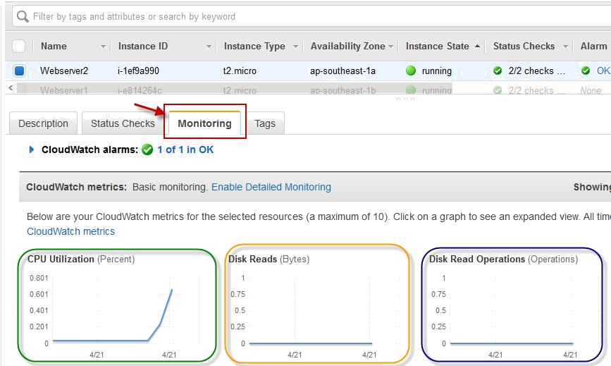
Once you are under EC2 dashboard, go to instances from left navigation pane, select your instance.
Once selected instance, select Monitoring tab under the instance, you can see all Monitoring metrics available for different types like CPU, Disk, Network, Status checks etc.

